Slide 1
Chapter 22 - C++ Templates
Outline
22.1 Introduction
22.2 Class Templates
22.3 Class Templates and Non-type Parameters
22.4 Templates and Inheritance
22.5 Templates and friends
22.6 Templates and static Members

Slide 2
Objectives
In this chapter, you will learn:
  To be able to use class templates to create a group of related types.
  To be able to distinguish between class templates and template classes.
  To understand how to overload template functions.
  To understand the relationships among templates, friends, inheritance and static members.

Slide 3
22.1 Introduction
Templates
  Easily create a large range of related functions or classes
  Function template - the blueprint of the related functions
  Template function - a specific function made from a function template

Slide 4
22.2 Class Templates
Class templates
  Allow type-specific versions of generic classes
Format:
  template <class T>
  class ClassName{
    definition
    }
  Need not use "T", any identifier will work
  To create an object of the class, type
    ClassName< type > myObject;
    Example: Stack< double > doubleStack;

Slide 5
22.2 Class Templates (II)
Template class functions
  Defined normally, but preceded by template<class T>
    Generic data in class listed as type T
  Binary scope resolution operator used
  Template class function definition:
  template<class T>
  MyClass< T >::MyClass(int size)
  {
  myArray = new T[size];
  }
    Constructor definition - creates an array of type T

Slide 6
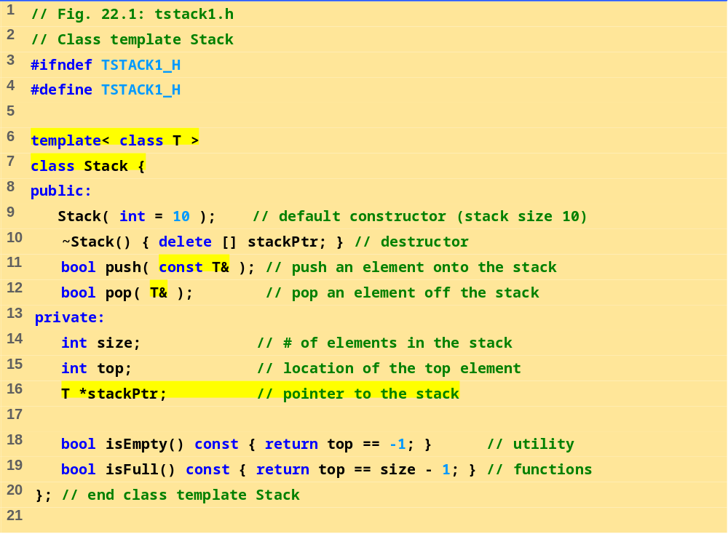
tstack1.h (Part 1 of 3)

Slide 7
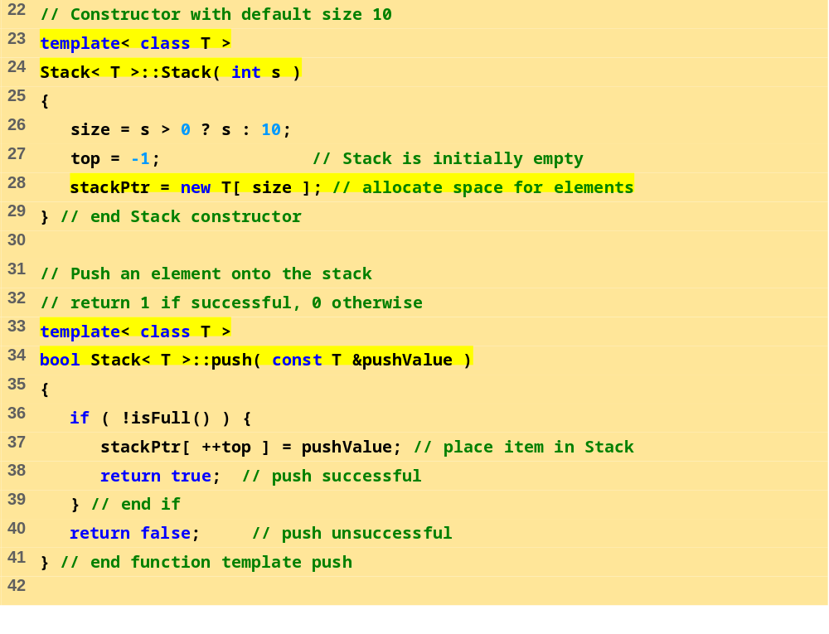
tstack1.h (Part 2 of 3)

Slide 8
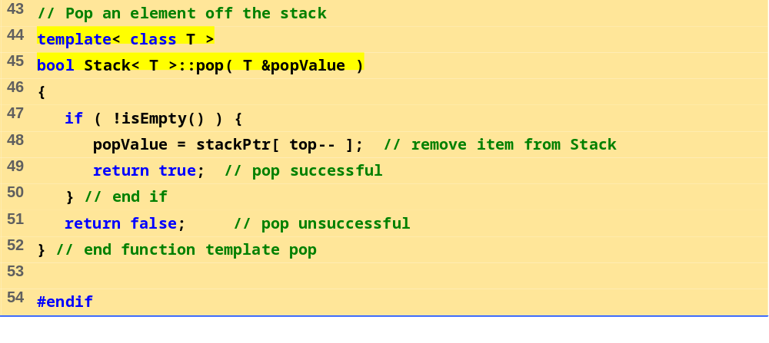
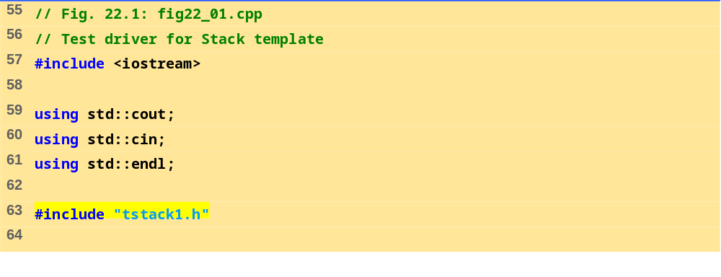
tstack1.h (Part 3 of 3)
fig22_01.cpp (Part 1 of 3)

Slide 9
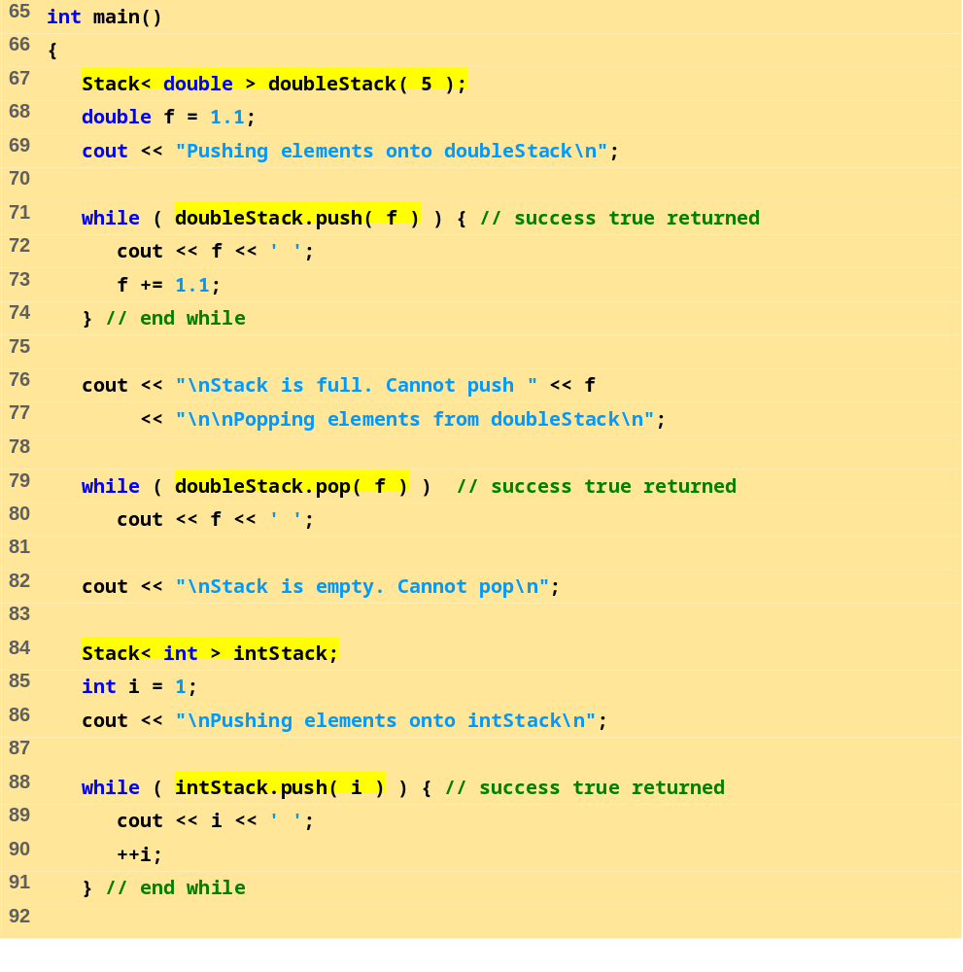
fig22_01.cpp (Part 2 of 3)

Slide 10
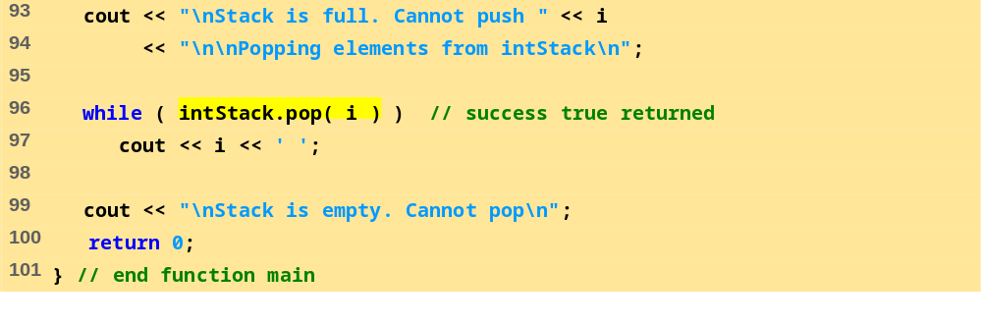
fig22_01.cpp (Part 3 of 3)
Program Output
Pushing elements onto doubleStack
1.1 2.2 3.3 4.4 5.5
Stack is full. Cannot push 6.6
Popping elements from doubleStack
5.5 4.4 3.3 2.2 1.1
Stack is empty. Cannot pop
Pushing elements onto intStack
1 2 3 4 5 6 7 8 9 10
Stack is full. Cannot push 11
Popping elements from intStack
10 9 8 7 6 5 4 3 2 1
Stack is empty. Cannot pop

Slide 11
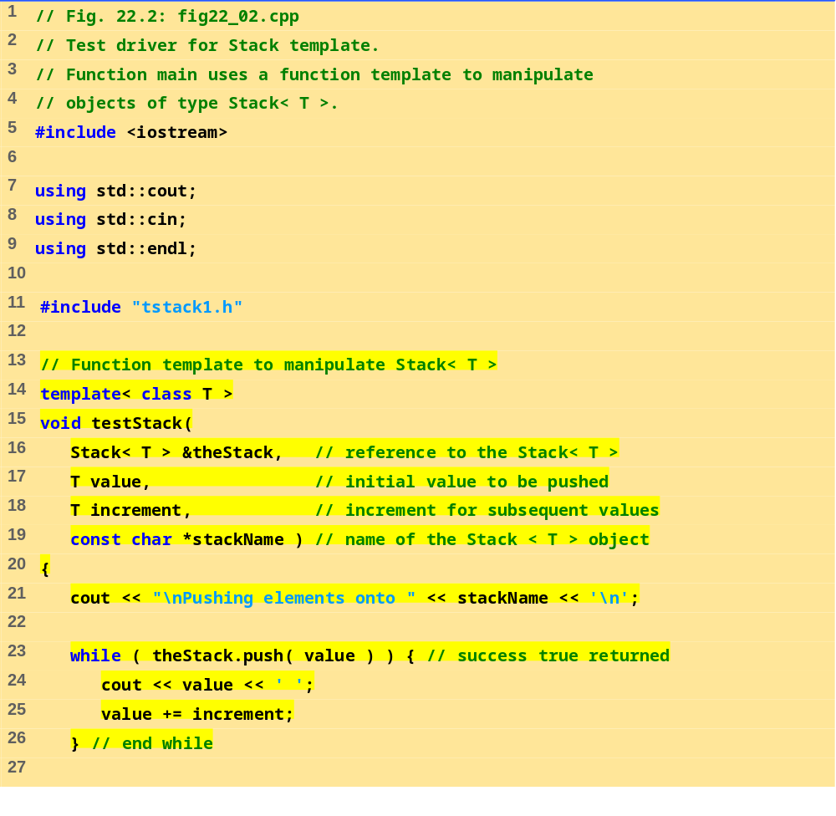
fig22_02.cpp (Part 1 of 2)

Slide 12
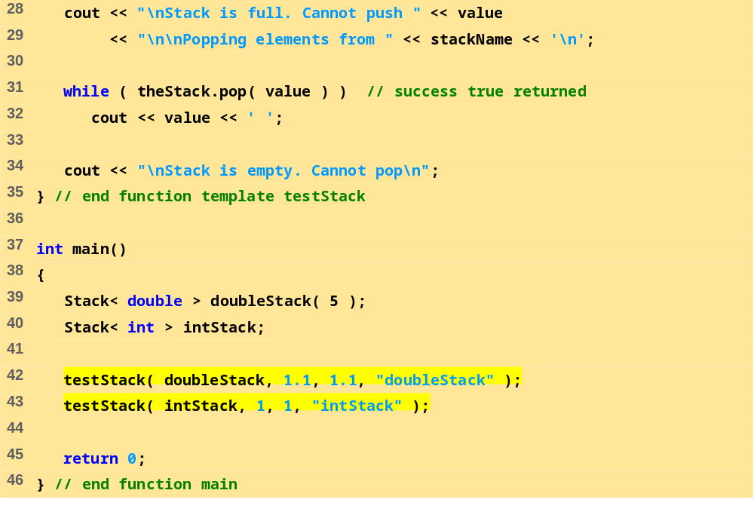
fig22_02.cpp (Part 2 of 2)

Slide 13
Pushing elements onto doubleStack
1.1 2.2 3.3 4.4 5.5
Stack is full. Cannot push 6.6
Popping elements from doubleStack
5.5 4.4 3.3 2.2 1.1
Stack is empty. Cannot pop
Pushing elements onto intStack
1 2 3 4 5 6 7 8 9 10
Stack is full. Cannot push 11
Popping elements from intStack
10 9 8 7 6 5 4 3 2 1
Stack is empty. Cannot pop
Program Output

Slide 14
22.3 Class Templates and Non-type Parameters
Can use non-type parameters in templates
  Default argument
  Treated as const
Example:
  template< class T, int elements >
  Stack< double, 100 > mostRecentSalesFigures;
    Defines object of type Stack< double, 100>
  This may appear in the class definition:
  T stackHolder[ elements ]; //array to hold stack
    Creates array at compile time, rather than dynamic allocation at execution time

Slide 15
22.3 Class Templates and Non-type Parameters (II)
Classes can be overridden
  For template class Array, define a class named
  Array<myCreatedType>
  This new class overrides then class template for myCreatedType
  The template remains for unoverriden types

Slide 16
22.4 Templates and Inheritance
A class template can be derived from a template class
A class template can be derived from a non-template class
A template class can be derived from a class template
A non-template class can be derived from a class template

Slide 17
22.5 Templates and friends
Friendships allowed between a class template and
  Global function
  Member function of another class
  Entire class
friend functions
  Inside definition of class template X:
  friend void f1();
    f1() a friend of all template classes
  friend void f2( X< T > & );
    f2( X< int > & ) is a friend of X< int > only. The same applies for float, double, etc.
  friend void A::f3();
    Member function f3 of class A is a friend of all template classes

Slide 18
22.5 Templates and friends (II)
  friend void C< T >::f4( X< T > & );
    C<float>::f4( X< float> & ) is a friend of class X<float> only
friend classes
  friend class Y;
    Every member function of Y a friend with every template class made from X
  friend class Z<T>;
    Class Z<float> a friend of class X<float>, etc.

Slide 19
22.6 Templates and static Members
Non-template class
  static data members shared between all objects
Template classes
  Each class (int, float, etc.) has its own copy of static data members
  static variables initialized at file scope
  Each template class gets its own copy of static member functions

